Slide 1
Restoration in the Presence of Noise Only using Spatial Filtering

Slide 2
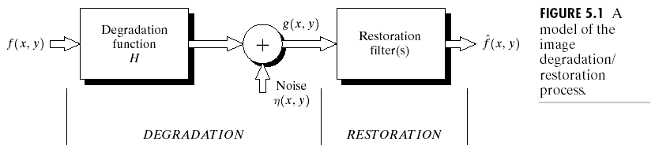
Additive noise only
g(x,y)=f(x,y)+η(x,y)
G(u,v)=F(u,v)+N(u,v)

Slide 3
Spatial filters for de-noising additive noise
Mean filters
  Arithmetic mean filter
  Geometric mean filter
  Harmonic mean filter
  Contra-harmonic mean filter
Order statistics filters
  Median filter
  Max and min filters
  Mid-point filter
  alpha-trimmed filters
Adaptive filters
  Adaptive local noise reduction filter
  Adaptive median filter

Slide 4
Mean filters
Arithmetic mean
Geometric mean
Window centered at (x,y)

Slide 5
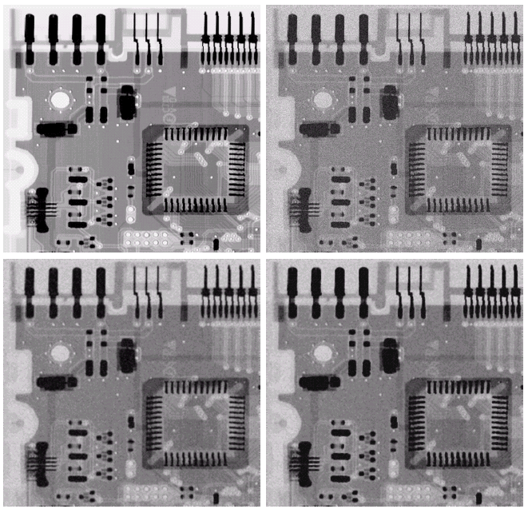
Noisy
Gaussian
original
μ=0
σ=20
Arith.
mean
Geometric
mean

Slide 6
Mean filters (cont.)
Harmonic mean filter
Contra-harmonic mean filter
Q=-1, harmonic
Q=0, airth. mean
Q=+, ?

Slide 7
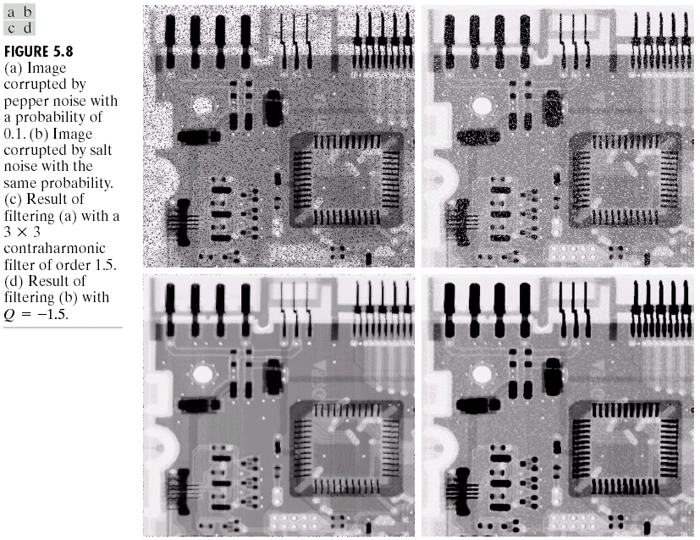
Pepper
Noise
Salt
Noise
Contra-
harmonic
Q=1.5
Contra-
harmonic
Q=-1.5

Slide 8
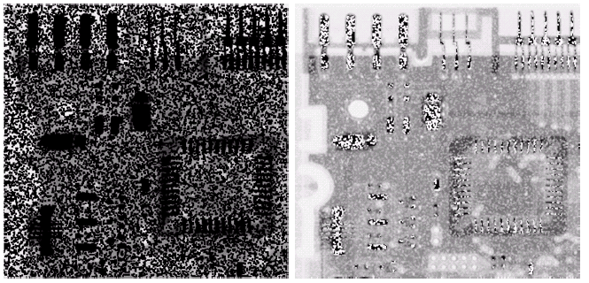
Wrong sign in contra-harmonic filtering
Q=-1.5
Q=1.5

Slide 9
Order-statistics filters
Based on the ordering(ranking) of pixels
  Suitable for unipolar or bipolar noise (salt and pepper noise)
Median filters
Max/min filters
Midpoint filters
Alpha-trimmed mean filters

Slide 10
Order-statistics filters
Median filter
Max/min filters

Slide 11
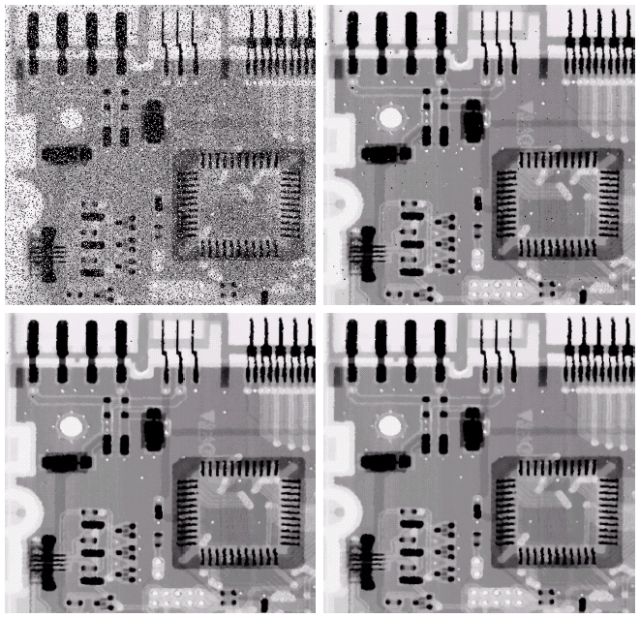
bipolar
Noise
P_{a} = 0.1
P_{b} = 0.1
3x3
Median
Filter
Pass 1
3x3
Median
Filter
Pass 2
3x3
Median
Filter
Pass 3

Slide 12
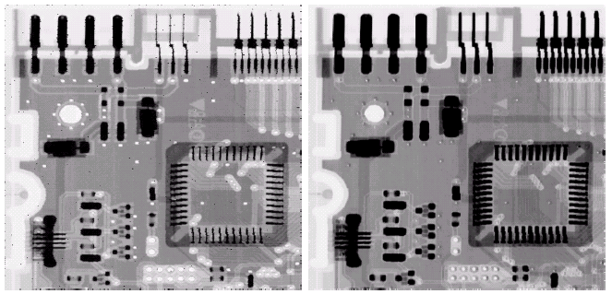
Pepper
noise
Salt
noise
Max
filter
Min
filter

Slide 13
Order-statistics filters (cont.)
Midpoint filter
Alpha-trimmed mean filter
  Delete the d/2 lowest and d/2 highest gray-level pixels
Middle (mn-d) pixels

Slide 14
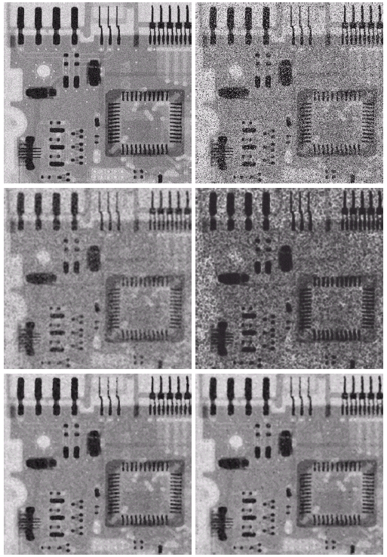
Uniform noise
Left +
Bipolar Noise
P_{a} = 0.1
P_{b} = 0.1
μ=0
σ²=800
5x5
Arith. Mean
filter
5x5
Geometric
mean
5x5
Median
filter
5x5
Alpha-trim.
Filter
d=5

Slide 15
Adaptive filters
Adapted to the behavior based on the statistical characteristics of the image inside the filter region S_{xy}
Simplest statistical measurement
  Mean and variance
Known parameters on local region S_{xy}
  g(x,y): noisy image pixel value
  σ²_{η}: noise variance (assume known a prior)
  m_{L} : local mean
  σ²_{L} : local variance

Slide 16
Adaptive local noise Reduction filter (cont.)
Analysis: we want to do
  If σ²_{η} is zero, return g(x,y)
  If σ²_{L}> σ²_{η} , return value close to g(x,y)
  If σ²_{L}= σ²_{η} , return the arithmetic mean m_{L}
Formula

Slide 17
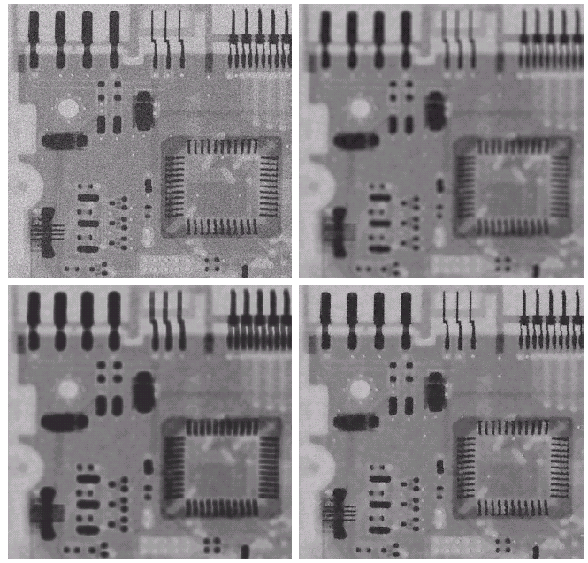
Gaussian
noise
Arith.
mean
7x7
μ=0
σ²=1000
adaptive
Geometric
mean
7x7

